Slide 1
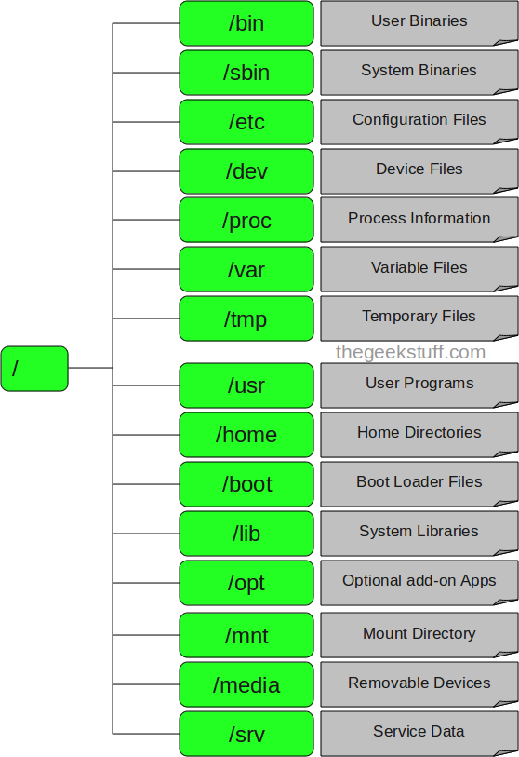

Linux directory structure
/ – Root
Every file and directory starts from the root directory.
Only the root user has write privilege under this directory.
/bin – User Binaries
Contains binary executables.
Common linux commands used in single-user mode located under this directory.
Example: ls, ping, grep, cp.
/sbin – System Binaries
Also contains binary executables.
System maintenance commands typically used by sys admin.
Examples: shutdown, fdisk, ifconfig
/etc – Configuration Files
Contains configuration files required by all programs.
Also contains startup and shutdown shell scripts used to start/stop programs.
Notes:
No registry like Windows, everything is stored in configuration files

Slide 2
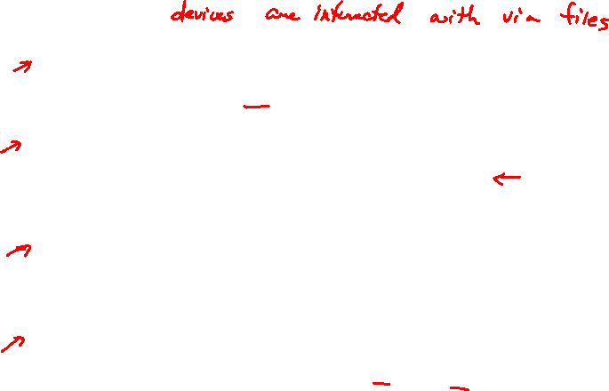
Linux directory structure
/dev – Device Files
Contains device files.
Include terminal devices, usb, or any device attached to the system.
/proc – Process Information
Contains information about system process.
Pseudo filesystem contains information about running process.
Virtual filesystem with text information about system resources.
/var – Variable Files
Content of files that are expected to grow.
Includes system log files; packages and database files; temp files needed across reboots
/tmp – Temporary Files
Directory that contains temporary files created by system and users.
Files under this directory are deleted when system is rebooted.

Slide 3

Linux directory structure
/usr – User Programs
Contains binaries, libraries, documentation, and source-code for second level programs.
If you can’t find a user binary under /bin, look under /usr/bin.
/usr/sbin contains binary files for system administrators.
If you can’t find a system binary under /sbin, look under /usr/sbin.
/home – Home Directories
Home directories for all users to store their personal files.
Example: /home/linus, /home/ken
/boot – Boot Loader Files
Contains boot loader related files, ie grub
/lib – System Libraries
Contains library files that supports the binaries located under /bin and /sbin

Slide 4
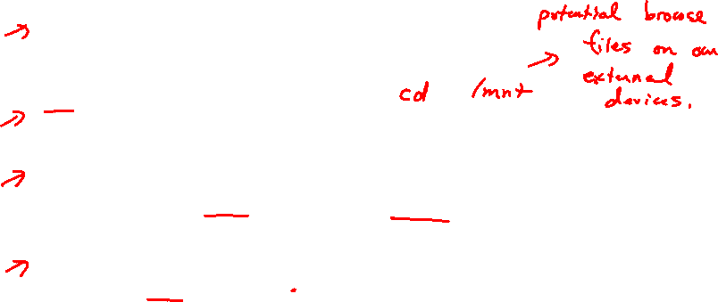
Linux directory structure
/opt – Optional add-on Applications
opt stands for optional.
Contains add-on applications from individual vendors.
/mnt – Mount Directory
Temporary mount directory where sysadmins can mount filesystems.
/media – Removable Media Devices
Temporary mount directory for removable devices.
Examples, /media/cdrom for CD-ROM; /media/floppy for floppy drives
/srv – Service Data
srv stands for service.
Contains server specific services related data.

